Slide 1
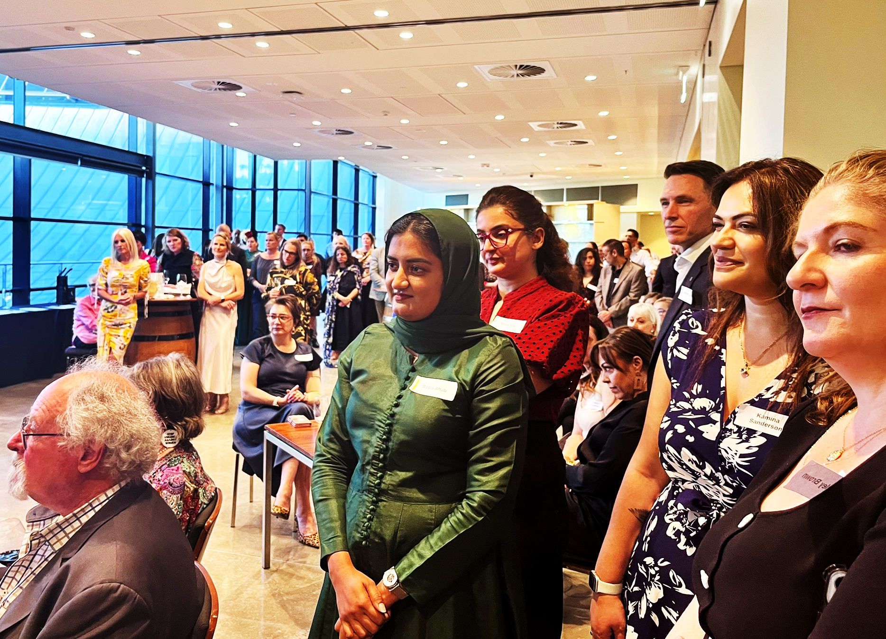

HERE FOR GOOD
FOUNDATION
ANNUAL REPORT
2024 – 2025
Building Unity. Breaking Cycles.

Slide 2

CONTENTS
01 Chairperson’s Message
02 Our Mission & Vision
03 About Us
04 Impact at a Glance
05 Our Programs
06 Hunt for a Hero Awards
07 2024 Award Winners
08 Men’s Learning Circles
09 Small Business Program
10 Education & Awareness
11 Volunteering
12 Community Stories
13 Financial Overview
14 Income & Expenditure
15 Our Board & Governance
16 Looking Ahead
17 Get Involved
18 Contact Us

Slide 3

CHAIRPERSON’S
MESSAGE
“
The 2024–2025 year has been one of tremendous growth and deepened commitment. Our Foundation continues to stand firmly against family and domestic violence, empowering individuals and communities to break cycles and build brighter futures.
Through our expanded programs — from the national Hunt for a Hero Awards to our Men’s Learning Circles — we’ve reached more people than ever before. Every story of resilience and courage reminds us why this work matters.
I’m deeply grateful to our board, volunteers, partners, and supporters who make this mission possible. Together, we are truly here for good.
Marina Pullin
Chairperson & Founder

Slide 4
OUR MISSION
& VISION
MISSION
We are dedicated to reducing family and domestic violence by creating awareness, encouraging honest conversations, supporting education, and connecting people with practical pathways to safety, dignity, and hope.
VISION
A future where every Australian lives free from family and domestic violence — where communities are united in compassion, equality, and action, and where every child grows up safe, valued, and supported.

Slide 5

ABOUT US
The Here for Good Foundation is a South Australian not-for-profit established in 2015, dedicated to ending the cycle of family and domestic violence through community education, awareness campaigns, and direct support programs.
FOUNDED
FOCUS
2015
FDV
Established in Adelaide, SA
Family & Domestic Violence
REACH
ABN
National
54 772 604 161
Programs across Australia
Registered Charity

Slide 6
IMPACT AT
A GLANCE
2024 – 2025 HIGHLIGHTS
4+
500+
8
Programs
Delivered
Lives
Impacted
Board
Members
50+
5
10
Volunteers
Engaged
Key
Partnerships
Years of
Service

Slide 7
OUR PROGRAMS
Our work is grounded in compassion, equality, and action. Through targeted programs, we empower communities to break cycles of violence and create lasting change.
1
Hunt for a Hero Awards
Celebrating individuals who stand up against domestic violence through our national peer-to-peer awards program.
2
Men’s Learning Circles
Creating safe spaces for men to explore the topic of domestic and family violence and be part of the change.
3
Sweartober
During October we challenge individuals, businesses to give up swearing or be fines as a way to draw attention to the impact of verbal abuse
4
Education & Awareness
Raising awareness about the impact of family violence through community education and quality information.
5
Volunteering
Providing growth opportunities for professionals to expand their individual impact on the community.

Slide 8
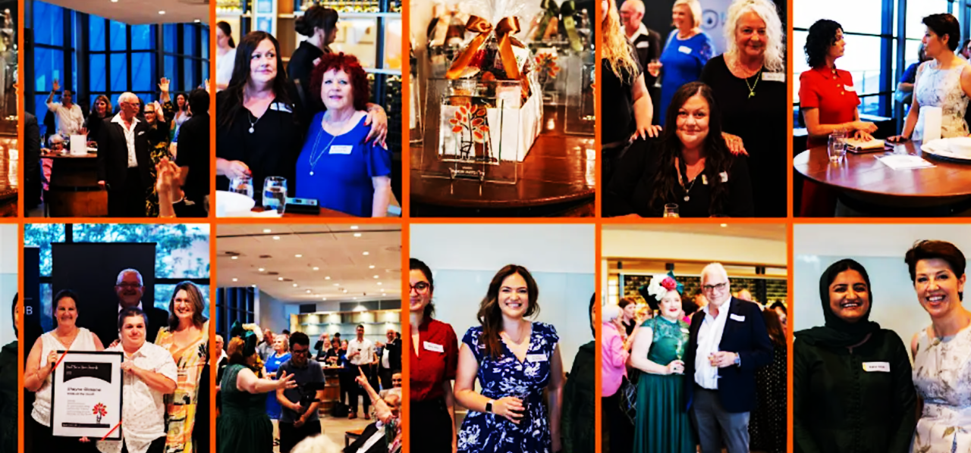
HUNT FOR
A HERO AWARDS
Our flagship program, the Hunt for a Hero Awards, celebrates the extraordinary efforts of individuals in our community who stand up, speak out, and help build a safer future for others through a peer-to-peer nomination process.
National peer-to-peer nomination and awards celebration
Recognises individuals creating sustainable change
Categories include Sustainable Change, Senior Superstar, and Support & Caring
Annual ceremony bringing together community champions
2025 awards ceremony successfully completed with record nominations

Slide 9
PAST AWARD
WINNERS
SUSTAINABLE CHANGE
Pam Aulich
Pam has dedicated 15 years to volunteering, offering unwavering support to individuals and families in need. Specialising in victim support, she has worked tirelessly to provide clothing, connect families with housing and food services, and rally the surrounding community.
SUPPORT & CARING
Mel Palmer
Mel is a devoted mother of three who has faced significant challenges with strength and resilience. Despite a long and difficult journey, she has remained focused on supporting her family and helping others in similar situations.

Slide 10

MEN’S LEARNING
CIRCLES
LAUNCHING 2026
Creating a safe space for men to explore the topic of domestic and family violence and be part of the solution. This groundbreaking program encourages open, honest conversations in a supportive group environment.
Safe & Supportive
Confidential group settings where men can speak openly without judgement
Education-Focused
Evidence-based content exploring the roots and impacts of family violence
Action-Oriented
Practical strategies for men to become advocates for change in their communities
Facilitated by Experts
Led by trained facilitators with experience in men’s behavioural change

Slide 11
SMALL BUSINESS
PROGRAM
Our Small Business Program offers workplaces access to speakers who share real stories and practical insights, keeping the conversation about family violence alive in professional settings.
01
Workplace Awareness
Equipping employers and staff with knowledge to recognise signs of domestic violence
02
Speaker Series
Powerful firsthand accounts and expert presentations that inspire action
03
Resource Sharing
Providing businesses with materials and referral pathways for affected employees

Slide 12
EDUCATION &
AWARENESS
Education is at the heart of everything we do. By raising awareness about the impact of family domestic violence, we empower communities with knowledge and understanding to create meaningful change.
Community information sessions and public forums
Quality resources and educational materials on family violence
School and university engagement programs
Social media campaigns driving national conversations
Partnerships with support organisations for referral pathways

Slide 13

VOLUNTEERING
We provide quality volunteering and growth opportunities for professionals to expand their individual impact on the community and contribute to positive social change.
50+
2,000+
15+
Volunteers
Volunteer Hours
Prevention Partner Organisations
Event Coordination
Supporting the planning and delivery of Foundation events including the Hunt for a Hero Awards
Community Outreach
Connecting with local communities, schools, and businesses to spread awareness
Professional Development
Volunteers gain leadership skills, networking
opportunities, and professional growth

Slide 14
COMMUNITY
STORIES
Behind every program is a real person whose life has been touched by the Foundation’s work. These stories of resilience remind us why we’re here for good.
“
“The Foundation’s support gave me the strength to rebuild my life. I went from feeling completely alone to being surrounded by a community that truly cares.”
— Program Participant
“
“Volunteering with HFGF has been transformative. I’ve seen firsthand how education and awareness can shift attitudes and save lives.”
— Foundation Volunteer
“
“The Hunt for a Hero Awards showed me that ordinary people can make an extraordinary difference. It inspired me to do more for my community.”
— Awards Nominee

Slide 15

FINANCIAL
OVERVIEW
2024 – 2025 FINANCIAL YEAR
As a small registered charity, we are committed to full financial transparency. Every dollar raised goes directly toward our mission of reducing family and domestic violence in Australian communities.
TOTAL REVENUE
PROGRAM SPEND
$25K
$15K
Grants, donations & fundraising
Direct program delivery costs
ADMIN COSTS
FUNDRAISING
12%
$13K
Of total expenditure
Raised through events & campaigns
* Illustrative figures based on publicly available charity data. Exact figures subject to audited accounts.

Slide 16
INCOME &
EXPENDITURE
INCOME SOURCES
Grants – Community Programs
Prevention Partners
Fundraising Events
Individual Donations
Other Income
EXPENDITURE BREAKDOWN
Program and Events
Community Education
Administration
Fundraising Costs
* Illustrative figures. Refer to audited financial statements for exact amounts.

Slide 17
OUR BOARD &
GOVERNANCE
Our board comprises experienced professionals bringing expertise across business, finance, community development, and governance to guide the Foundation’s strategic direction.
M
Marina Pullin
A
Alex Conway
Chairperson & Founder
Deputy Chairperson
R
Rhia Daniel
V
Victoria Kardasis
Communications Director
Grants & Fundraising Director
P
Peter Habel
S
Sharon Nelson
Community Projects Director
Expert Advisor
The Foundation operates with integrity, sound judgement, and a strong commitment to delivering positive outcomes for the communities we serve.

Slide 18
LOOKING
AHEAD
2025 – 2026 PRIORITIES
1
Launch Men’s Learning Circles
Roll out our inaugural men’s education program across South Australia in 2026
2
Expand National Reach
Grow the Hunt for a Hero Awards to engage more communities across all states
3
Strengthen Partnerships
Deepen relationships with government, corporate, and community organisations
4
Increase Fundraising
Diversify revenue streams and grow our supporter base for long-term sustainability
5
Digital Engagement
Expand online education resources and social media advocacy campaigns

Slide 19
GET
INVOLVED
There are many ways you can support the Here for Good Foundation and help us create lasting change in our communities.
$
DONATE
Your financial contribution directly funds our programs and helps us reach more people in need. Every dollar makes a difference.
V
VOLUNTEER
Join our team of dedicated volunteers and lend your skills, time, and energy to making our community safer for everyone.
P
PREVENTION PARTNER
Businesses and organisations can partner with us through sponsorship, in-kind support, or hosting workplace programs.
N
NOMINATE
Know someone making a difference? Nominate them for the Hunt for a Hero Awards and celebrate their courage.

Slide 20

THANK YOU
We’re all here for good.
hfgf.org.au
crew@hfgf.org.au
(08) 8180 0601
89 Pirie Street, Adelaide SA 5000
ABN 54 772 604 161 | Registered Charity
Building Unity. Breaking Cycles.

